Slide 1
Parametric Dataset
Ising Model of a Ferromagnet

Slide 2
I0 = 3, N = 10

Slide 3
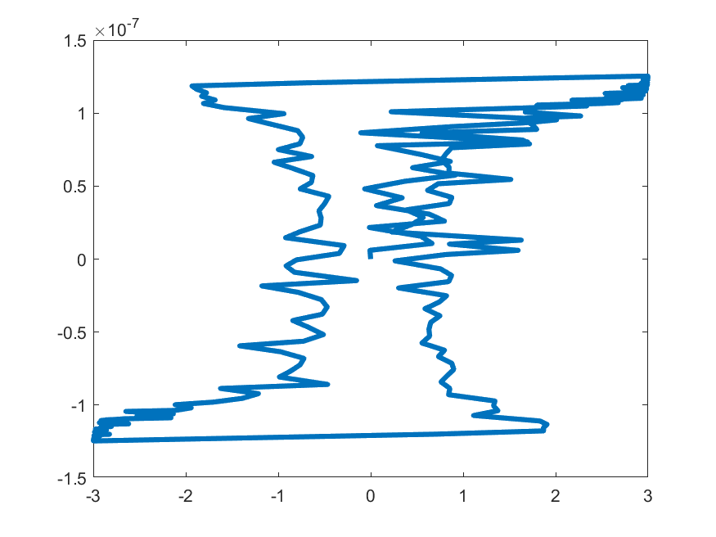
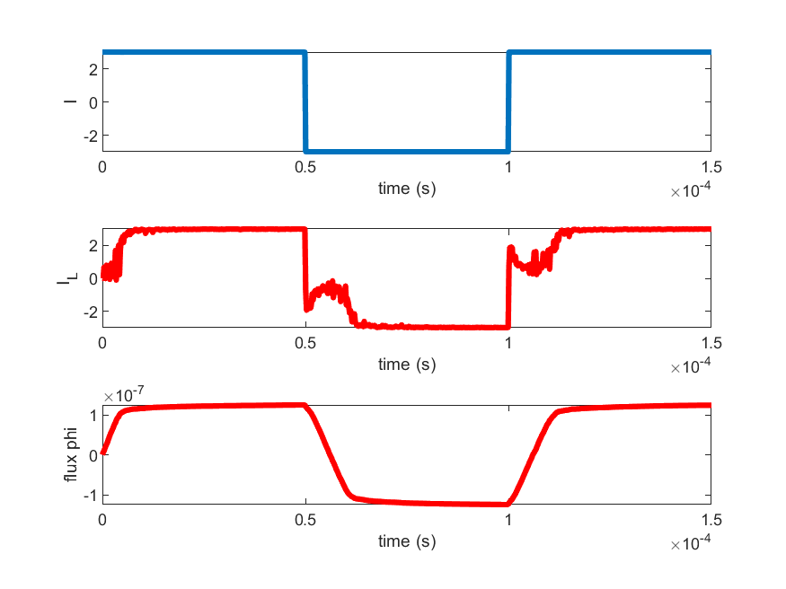
kT = 0.2eV, J = 0.5 eV, Hc = 1e3 m/(A eV) , Mc = 1e5 (A/m), R = 0.01 ohm

Slide 4
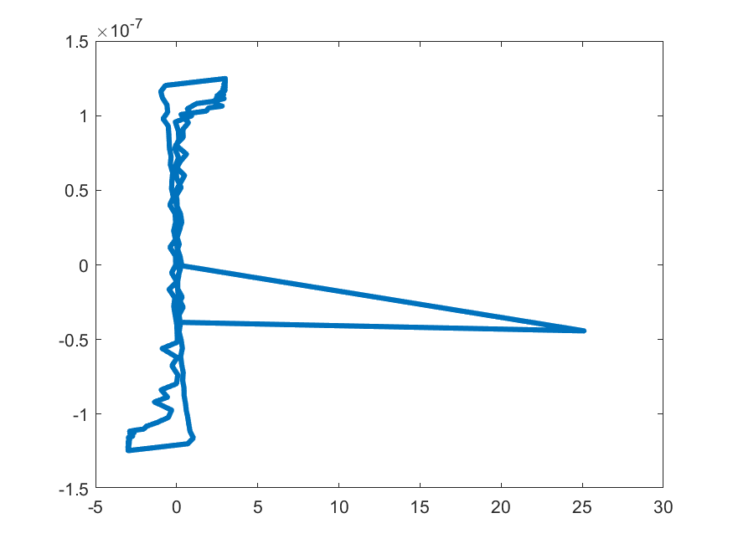
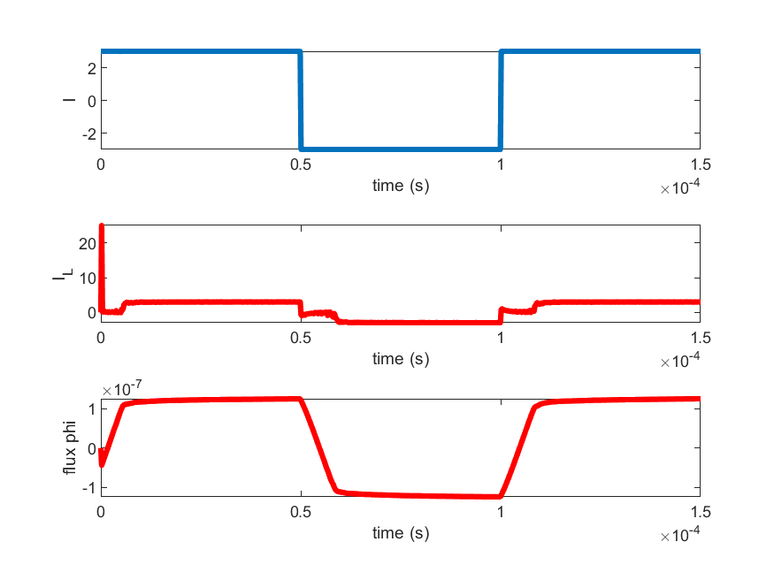
kT = 0.2eV, J = 0.3 eV, Hc = 1e3 m/(A eV) , Mc = 1e5 (A/m), R = 0.01 ohm

Slide 5
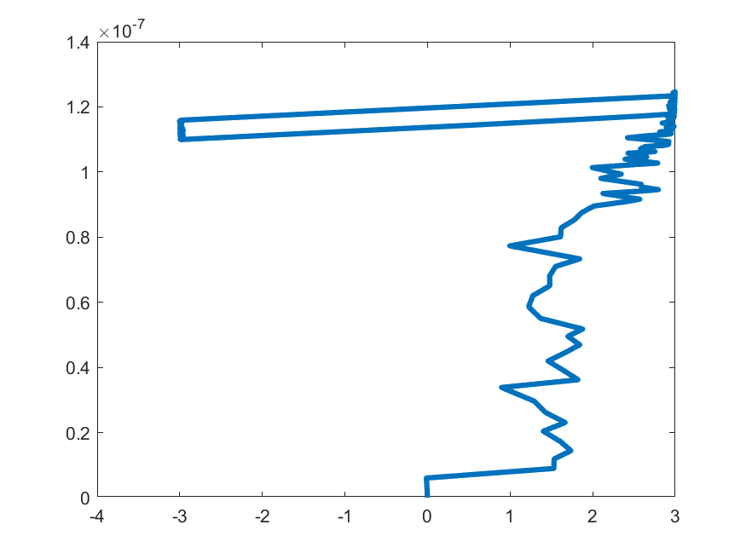
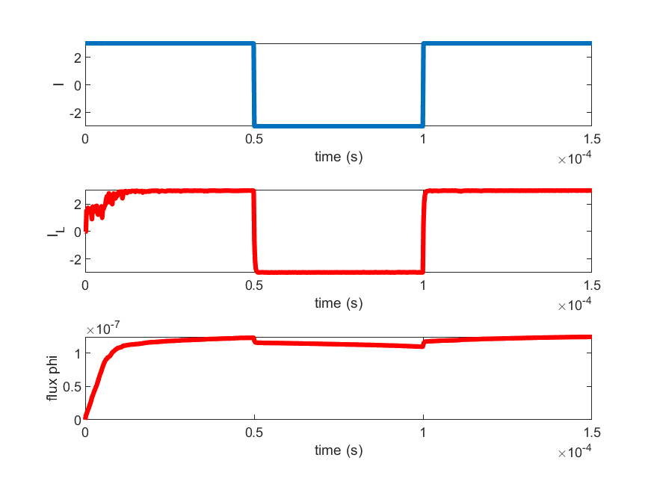
kT = 0.2eV, J = 1 eV, Hc = 1e3 m/(A eV) , Mc = 1e5 (A/m), R = 0.01 ohm

Slide 6
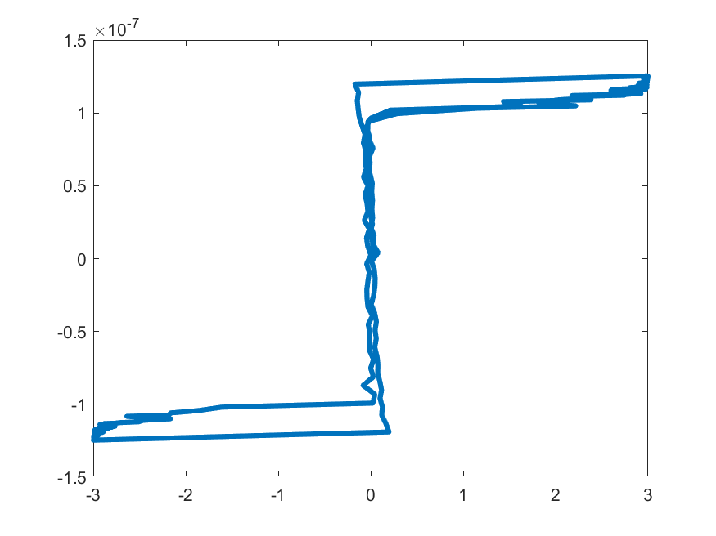
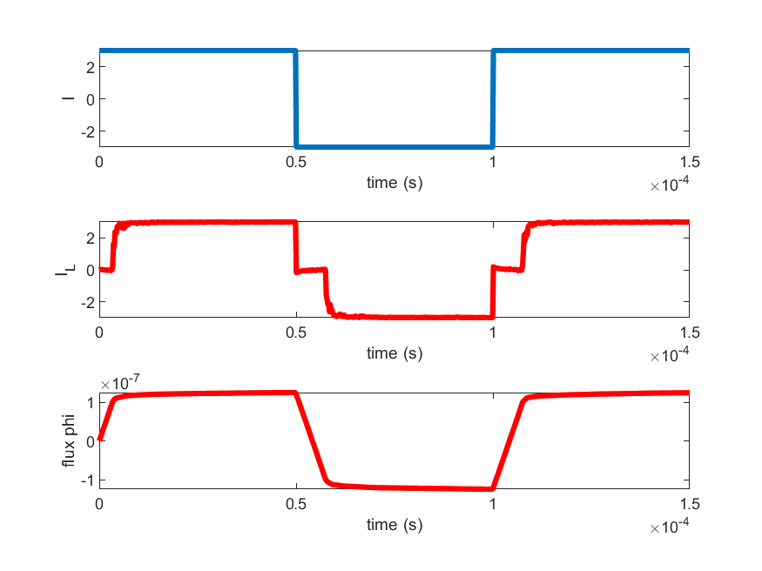
kT = 0.2eV, J = 0.1 eV, Hc = 1e3 m/(A eV) , Mc = 1e5 (A/m), R = 0.01 ohm

Slide 7
kT = 0.2eV, J = 0.01 eV, Hc = 1e3 m/(A eV) , Mc = 1e5 (A/m), R = 0.01 ohm
Does not converge.

Slide 8
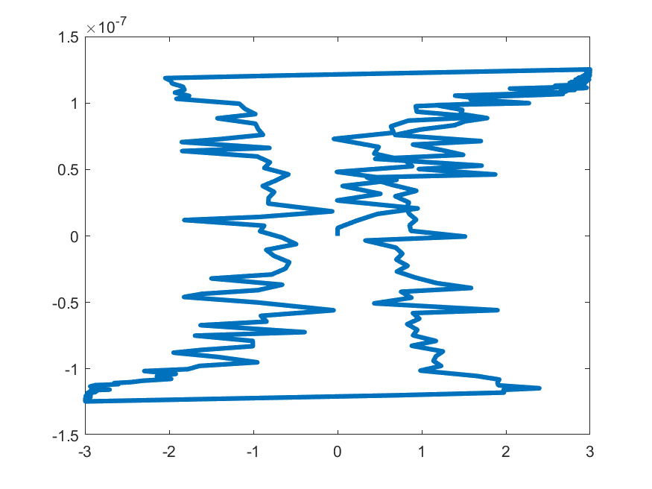
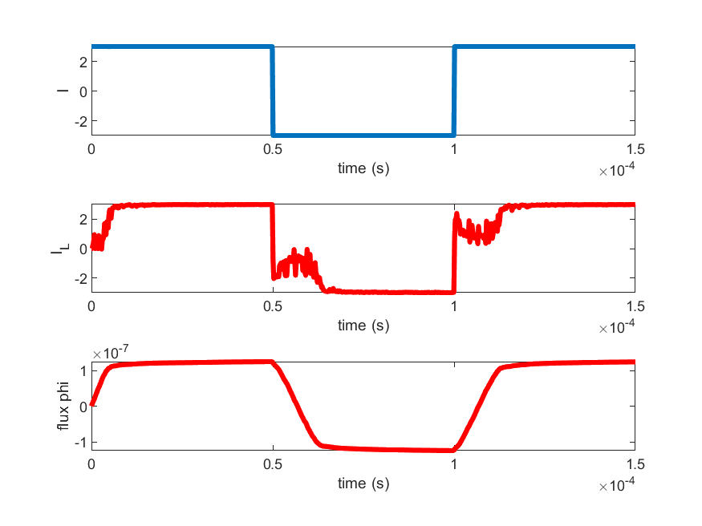
kT = 0.02eV, J = 0.5 eV, Hc = 1e3 m/(A eV) , Mc = 1e5 (A/m), R = 0.01 ohm

Slide 9
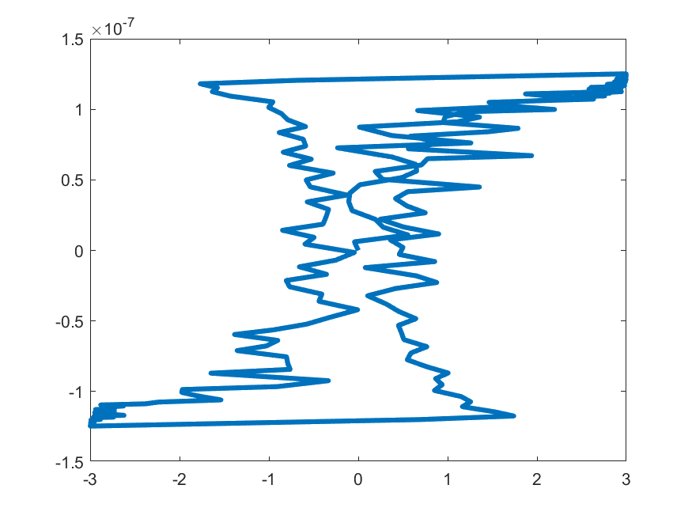

kT = 0.5eV, J = 0.5 eV, Hc = 1e3 m/(A eV) , Mc = 1e5 (A/m), R = 0.01 ohm

Slide 10
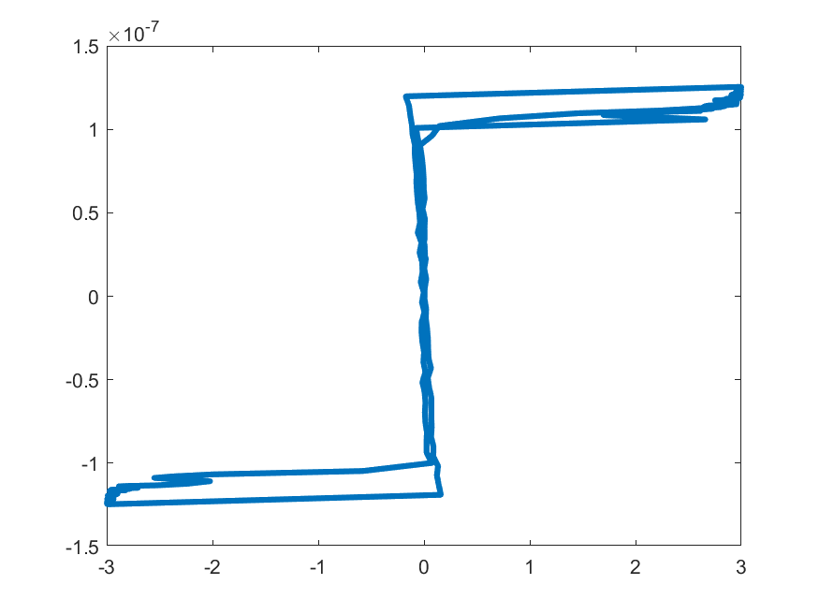

kT = 0.026eV, J = 0.05 eV, Hc = 1e3 m/(A eV) , Mc = 1e5 (A/m), R = 0.01 ohm

Slide 11
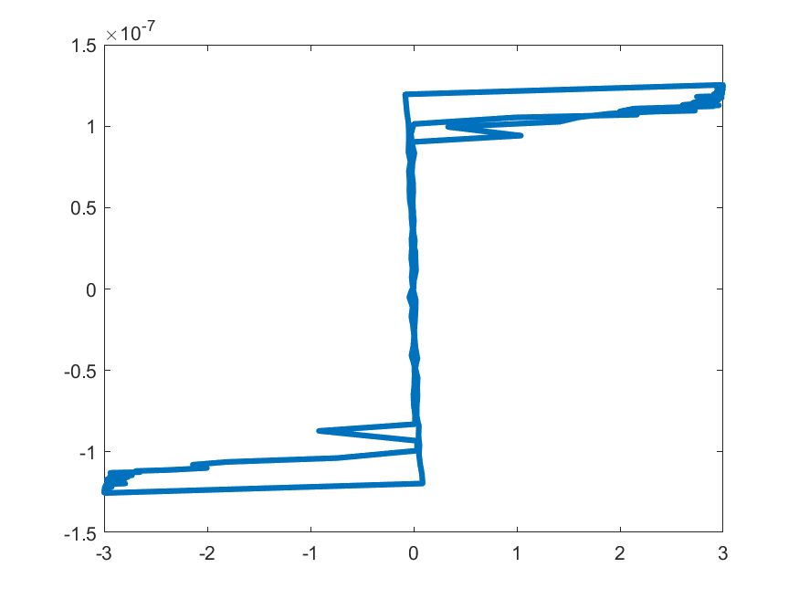

kT = 0.026eV, J = 0.03 eV, Hc = 1e3 A/(m eV) , Mc = 1e5 (A/m), R = 0.01 ohm

Slide 12
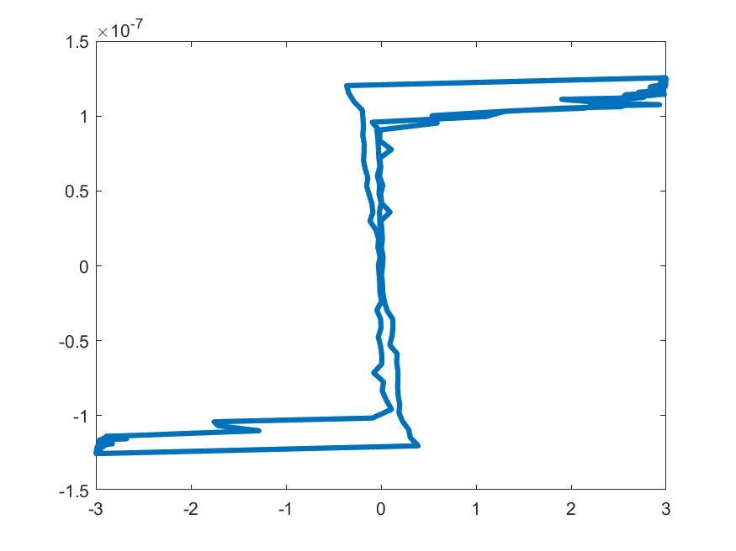

kT = 0.026eV, J = 0.1 eV, Hc = 1e3 m/(A eV) , Mc = 1e5 (A/m), R = 0.01 ohm

Slide 13
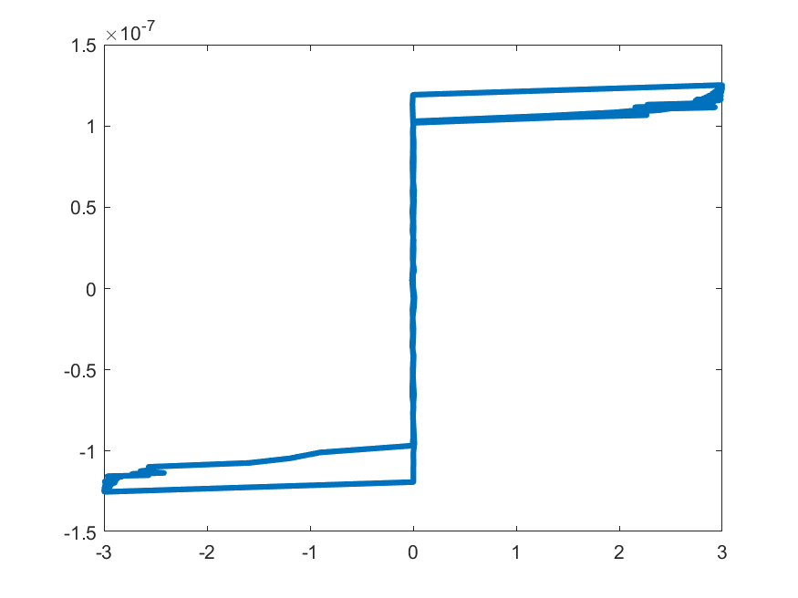
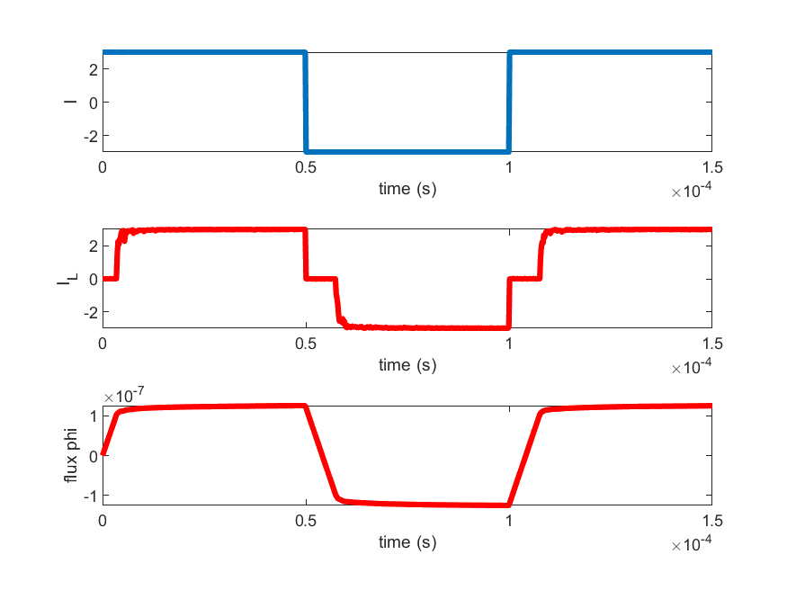
kT = 0.026eV, J = 0.01 eV, Hc = 1e3 m/(A eV) , Mc = 1e5 (A/m), R = 0.01 ohm

Slide 14
I0 = 1, N = 20

Slide 15
kT = 0.026eV, J = 0.05 eV, Hc = 1e3 m/(A eV) , Mc = 1e5 (A/m), R = 0.01 ohm
Does not converge

Slide 16
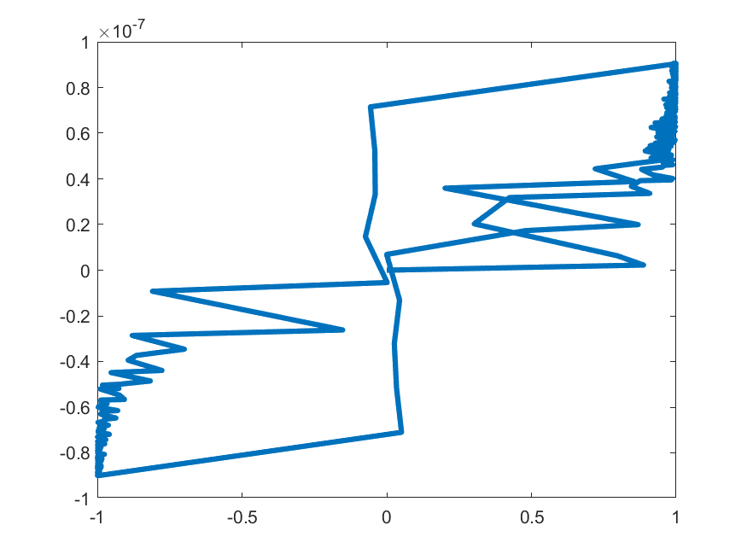
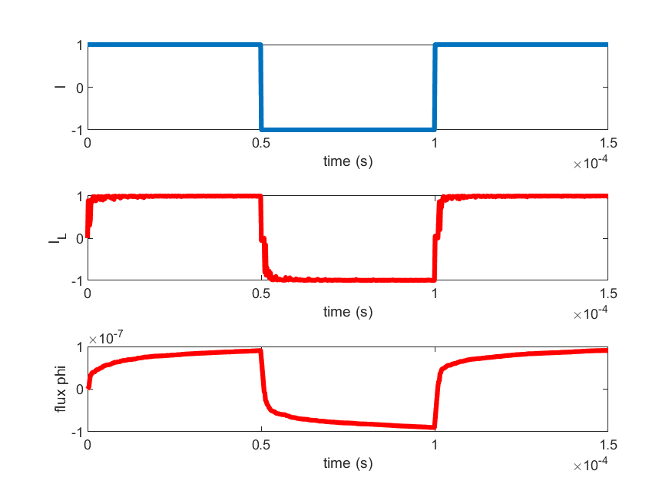
kT = 0.026eV, J = 0.05 eV, Hc = 1e3 m/(A eV) , Mc = 1e5 (A/m), R = 0.1 ohm

Slide 17
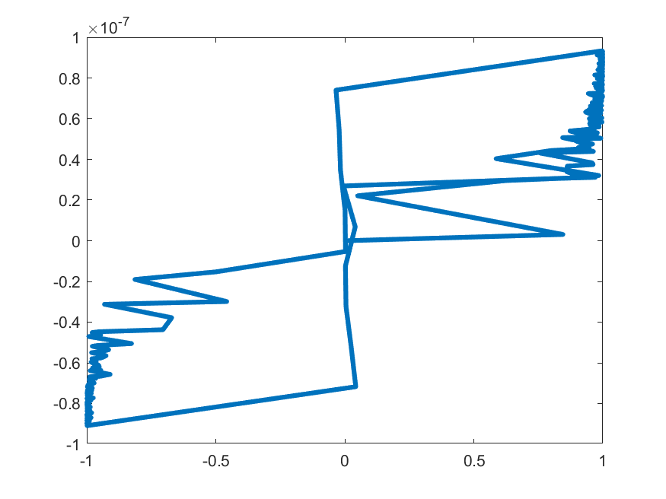
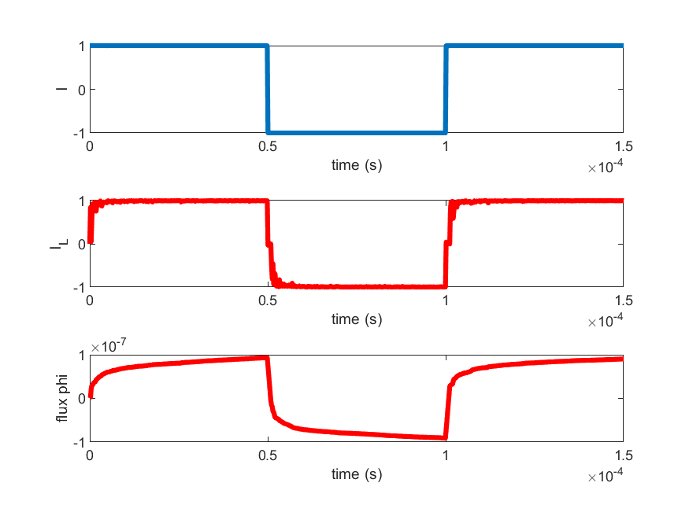
kT = 0.026eV, J = 0.03 eV, Hc = 1e3 m/(A eV) , Mc = 1e5 (A/m), R = 0.1 ohm

Slide 18
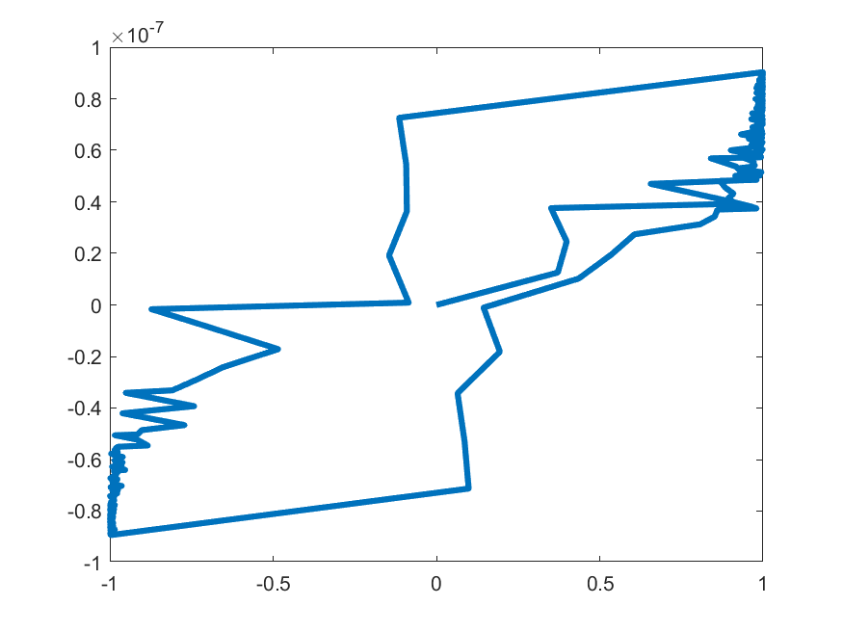
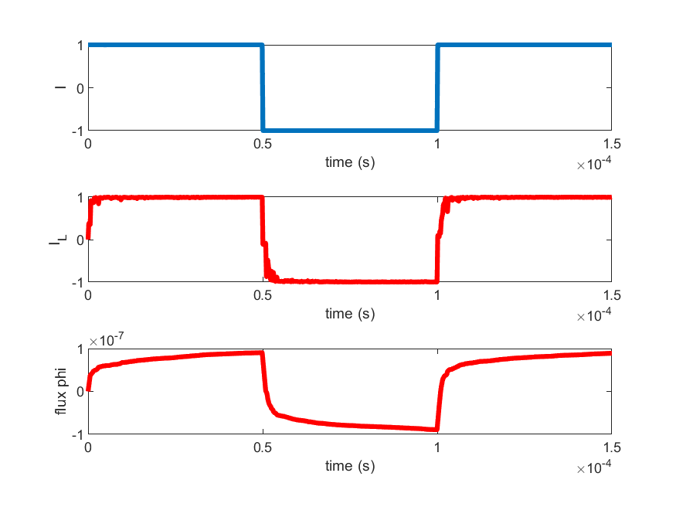
kT = 0.026eV, J = 0.1 eV, Hc = 1e3 m/(A eV) , Mc = 1e5 (A/m), R = 0.1 ohm

Slide 19
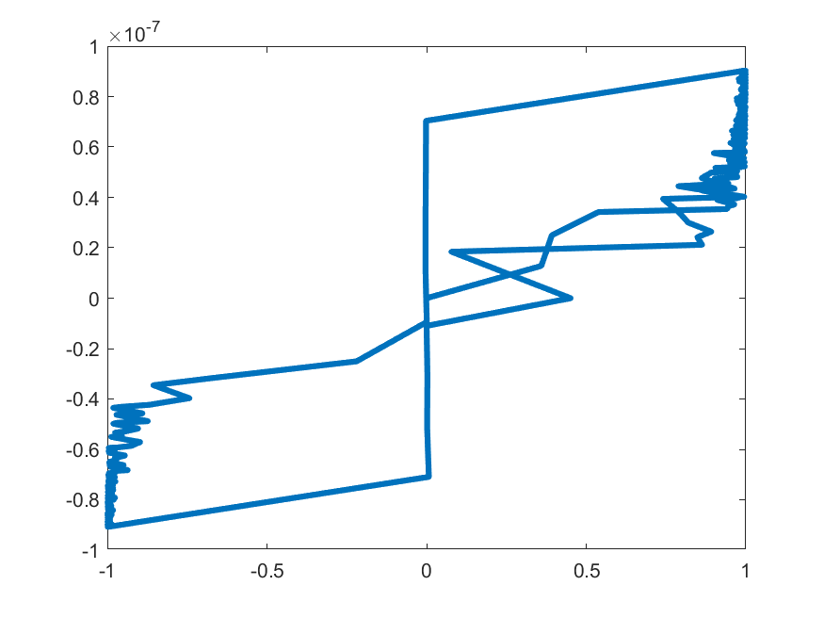
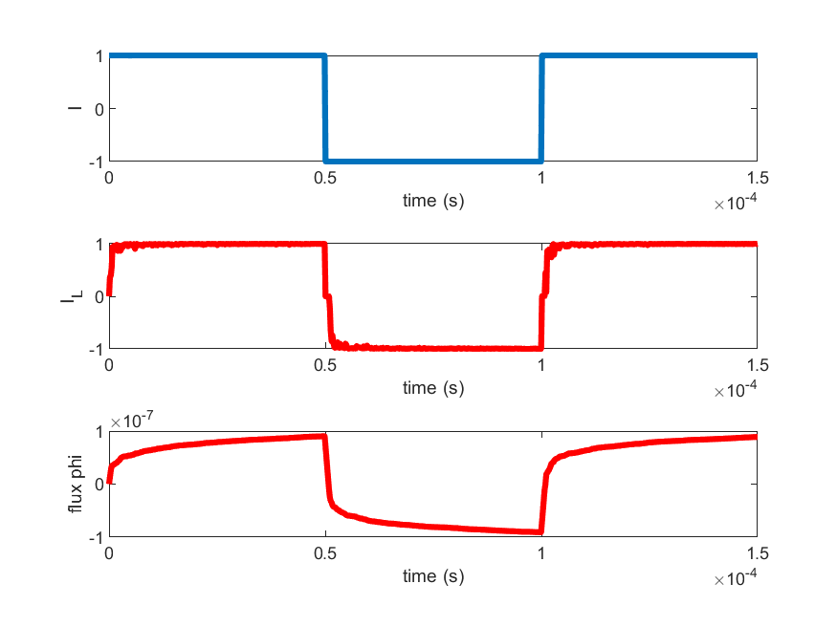
kT = 0.026eV, J = 0.01 eV, Hc = 1e3 m/(A eV) , Mc = 1e5 (A/m), R = 0.1 ohm

Slide 20
I0 = 1, N = 40

Slide 21
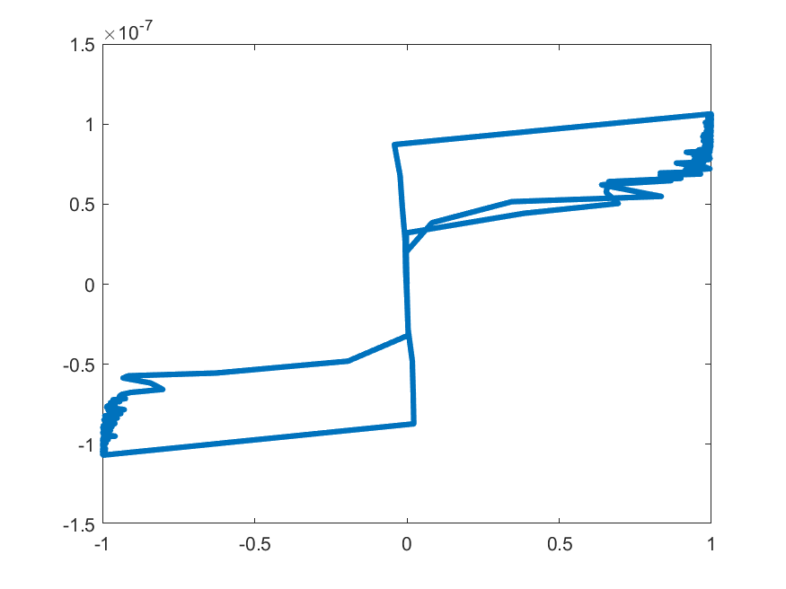
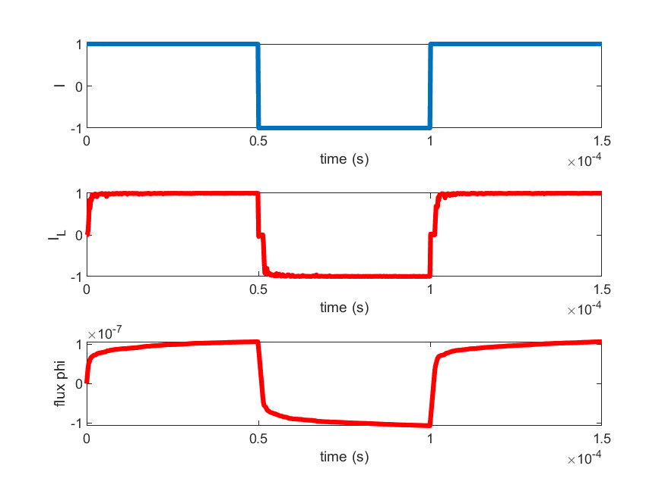
kT = 0.026eV, J = 0.05 eV, Hc = 1e3 m/(A eV) , Mc = 1e5 (A/m), R = 0.1 ohm

Slide 22
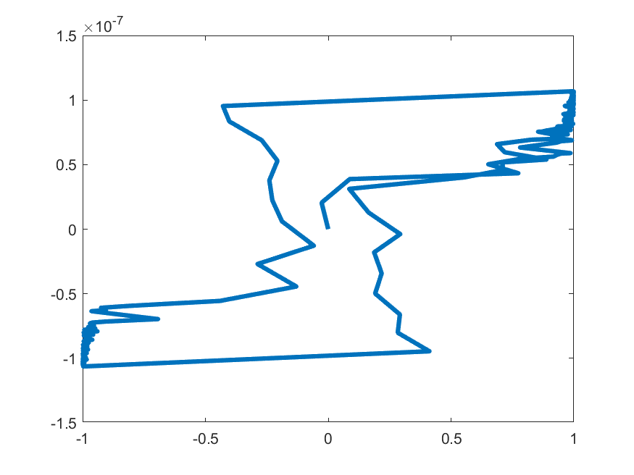
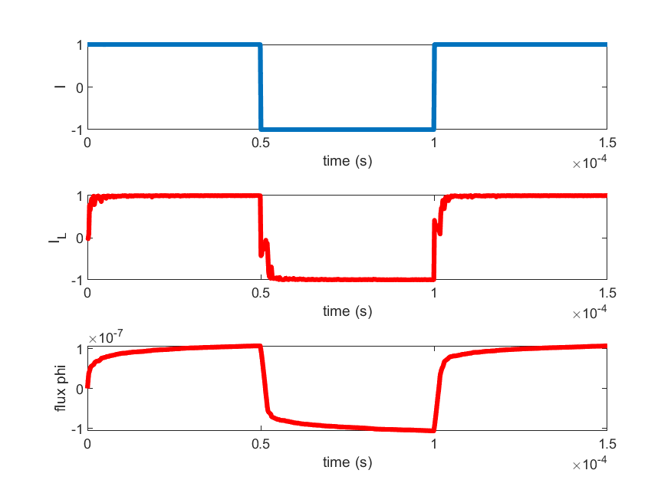
kT = 0.026eV, J = 0.05 eV, Hc = 1e4 m/(A eV) , Mc = 1e5 (A/m), R = 0.1 ohm

Slide 23
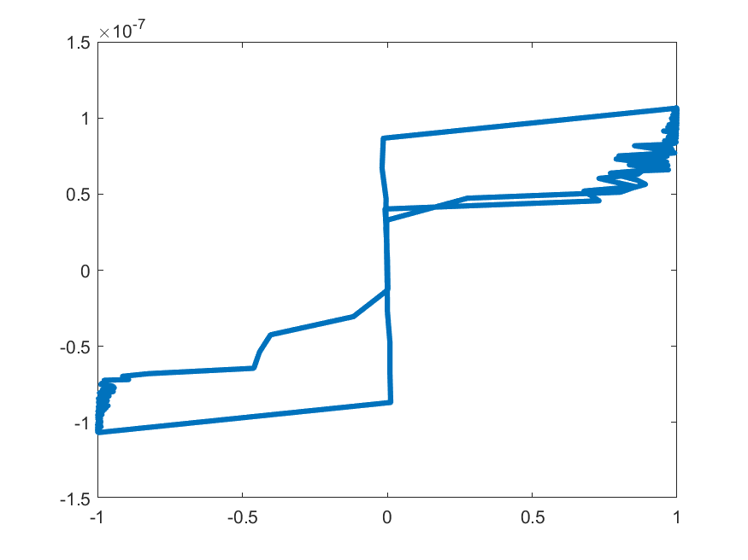
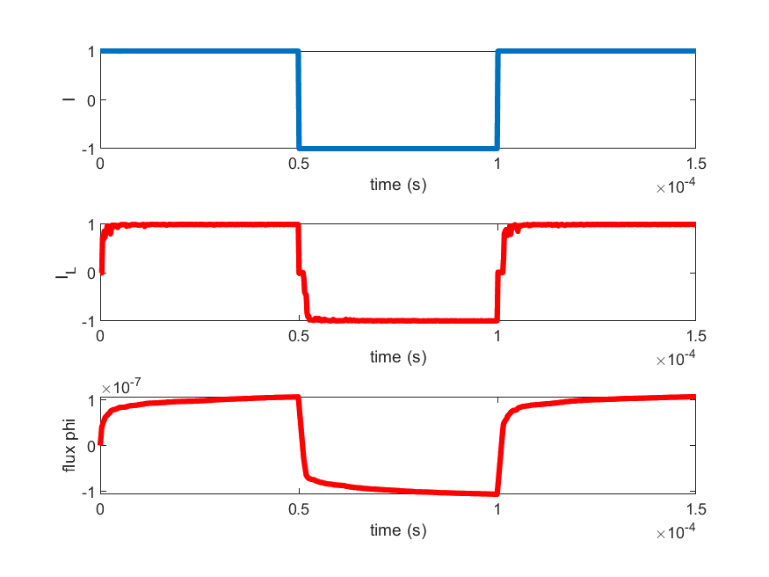
kT = 0.026eV, J = 0.03 eV, Hc = 1e3 m/(A eV) , Mc = 1e5 (A/m), R = 0.1 ohm

Slide 24
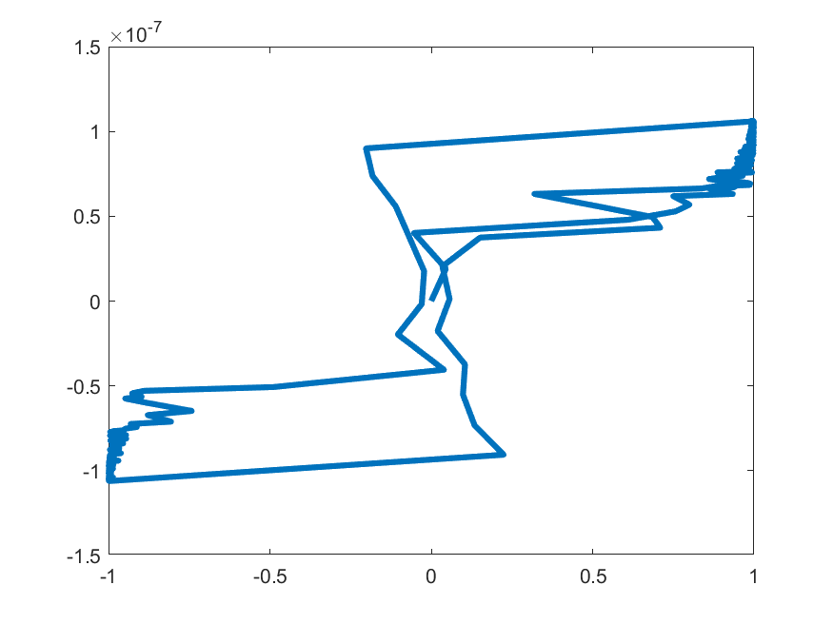
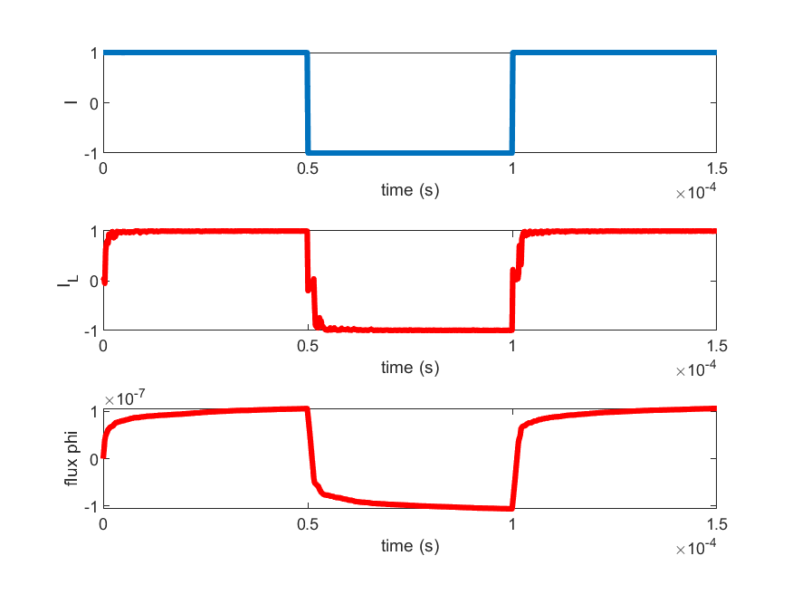
kT = 0.026eV, J = 0.03 eV, Hc = 1e4 m/(A eV) , Mc = 1e5 (A/m), R = 0.1 ohm

Slide 25
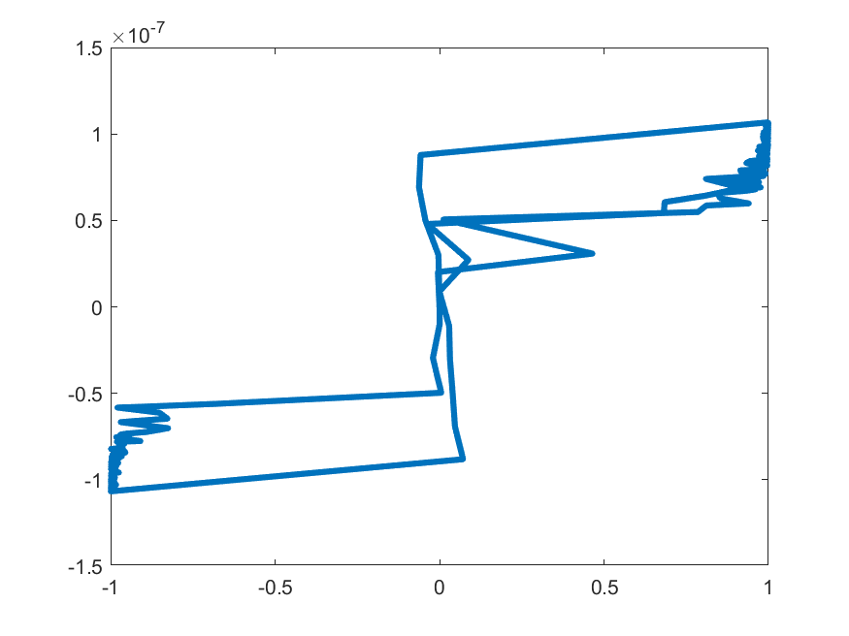
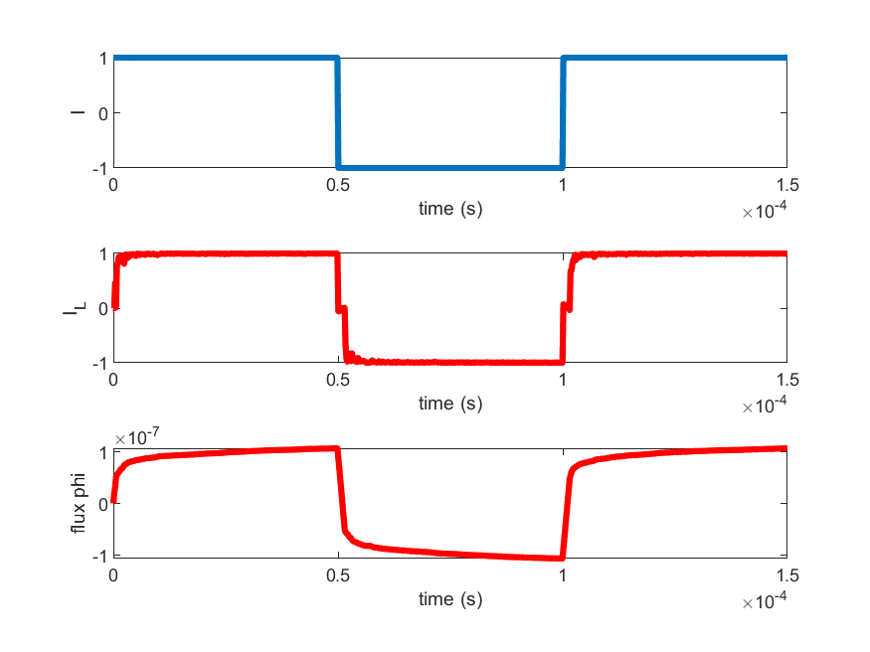
kT = 0.026eV, J = 0.1 eV, Hc = 1e3 m/(A eV) , Mc = 1e5 (A/m), R = 0.1 ohm

Slide 26
I0 = 0.5, N = 20

Slide 27
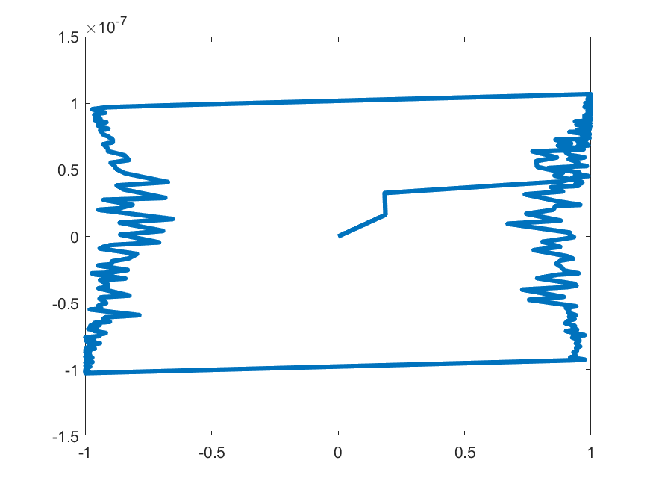
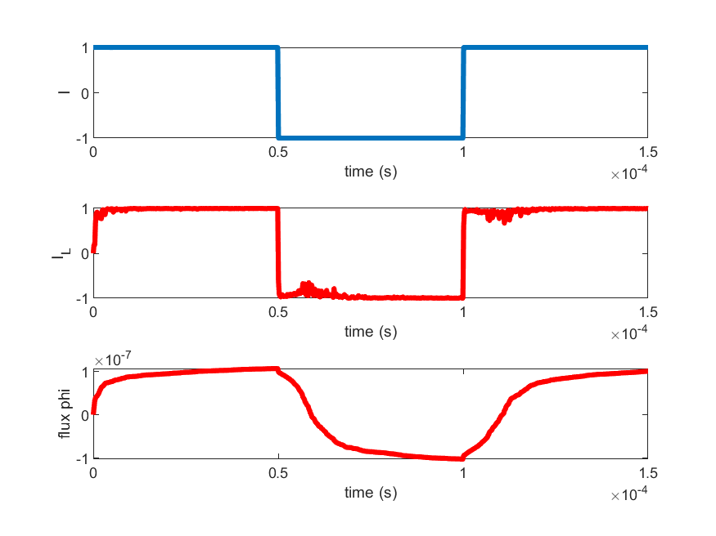
kT = 0.026eV, J = 0.1 eV, Hc = 1e4 m/(A eV) , Mc = 1e5 (A/m), R = 0.1 ohm

Slide 28
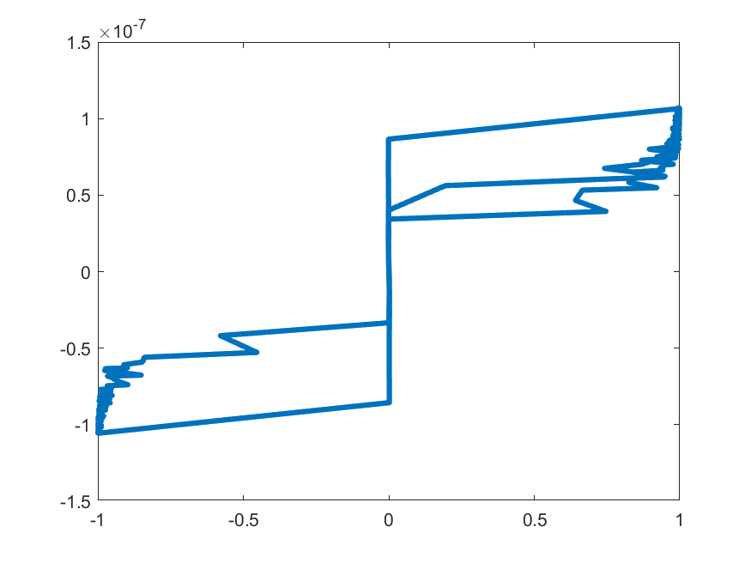
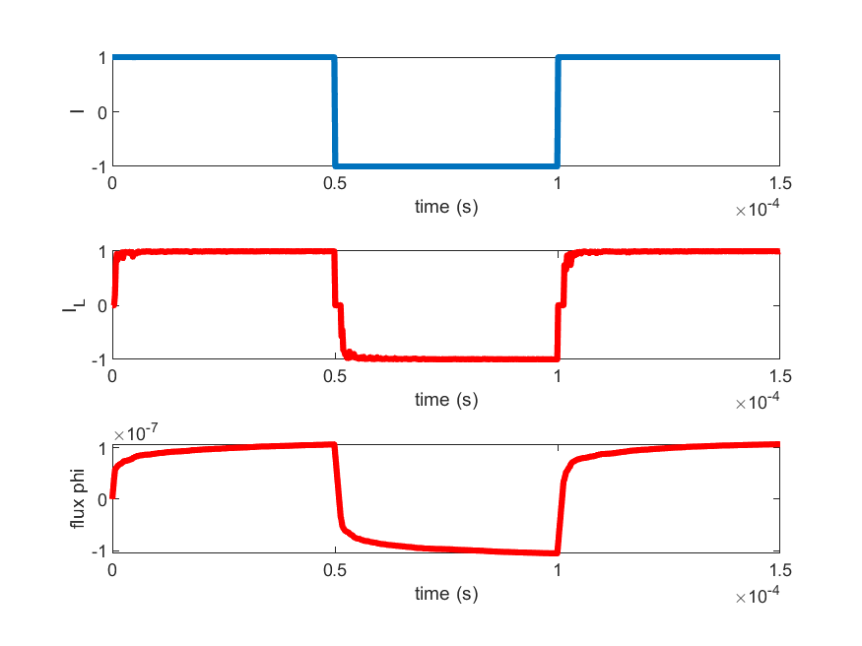
kT = 0.026eV, J = 0.01 eV, Hc = 1e3 m/(A eV) , Mc = 1e5 (A/m), R = 0.1 ohm

Slide 29
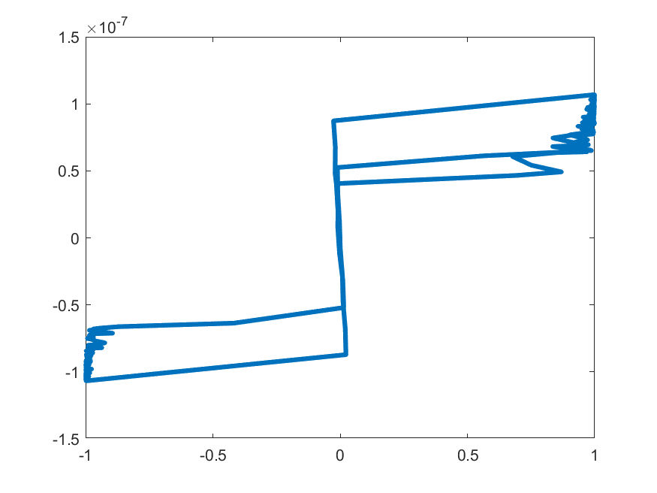

kT = 0.026eV, J = 0.01 eV, Hc = 1e4 m/(A eV) , Mc = 1e5 (A/m), R = 0.1 ohm

Slide 30
kT = 0.026eV, J = 0.05 eV, Hc = 1e3 m/(A eV) , Mc = 1e5 (A/m), R = 0.1 ohm

Slide 31
Iteration taken for each time step convergence

Slide 32
The default Parameters (only the change will mention in the slides
%time definition and switching speed need to be defined
Time = 0.5e-4;
dt = 0.2e-6;
n = floor(Time/dt);
sw_speed = 1e7; %number of switches in one second
mc_steps = sw_speed*dt ;
%Signal
Io = 3;
I = [Io*ones(1,n),-Io*ones(1,n),Io*ones(1,n)];
%convergence condition
err = 1e-9;
Nx=25;
Ny=25;
Nz=70;
T = 0.2; %tempreture why??
k = 1;
J = 0.5;
mu_0 = 4*pi*1e-7;
%core properties
NuT = 10;
Lc = 0.01;
A = 1e-6;
R = 1e-2;
%scaling
Hc = 1e3;
Mc = 1e5;
The working version of the code is uploaded in GIT, for backup if I mess-up again

Slide 33
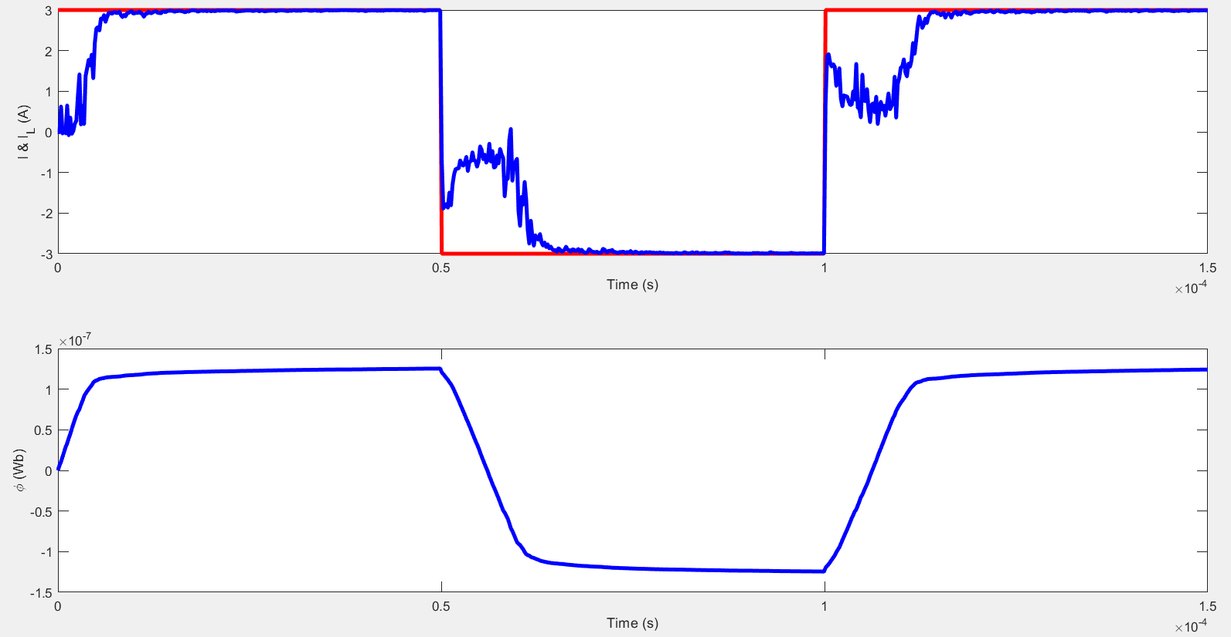
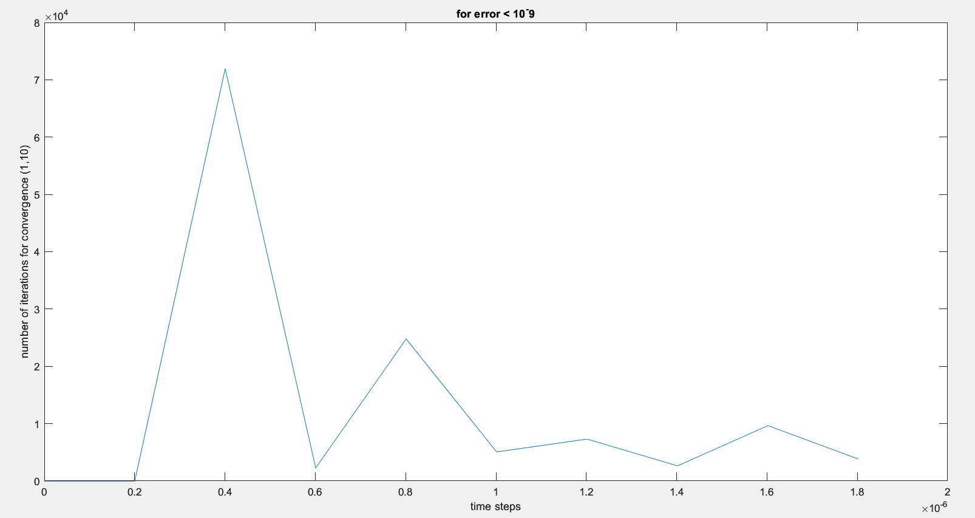
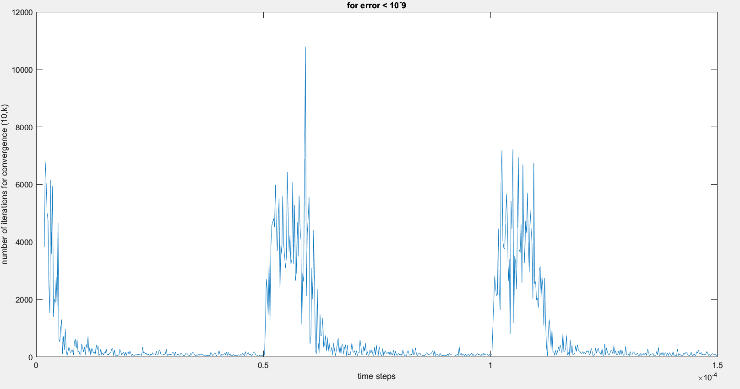
Iteration taken for each time step convergence
Result of the simulation
Takes more time to converge when the input switch's

Slide 34
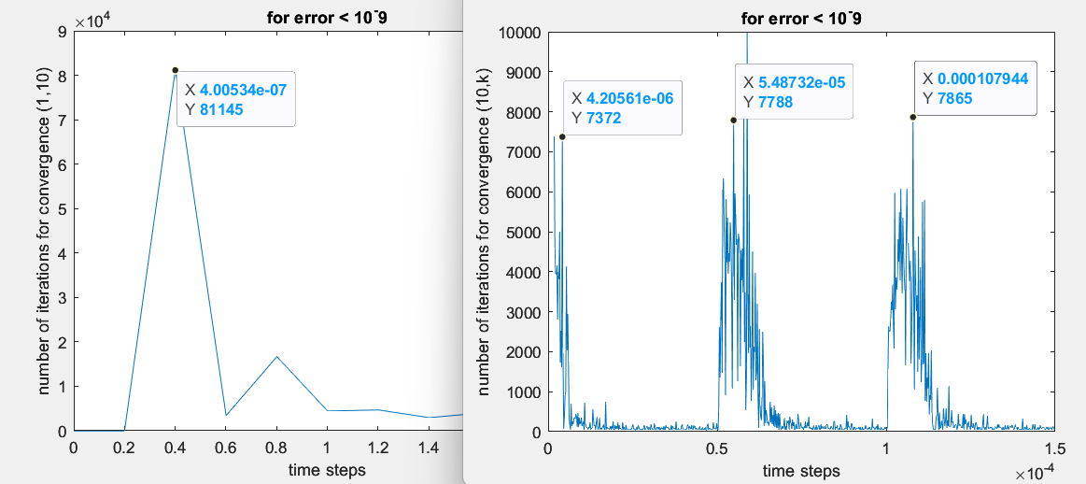
Iteration taken for each time step convergence
Result of the simulation

Slide 35
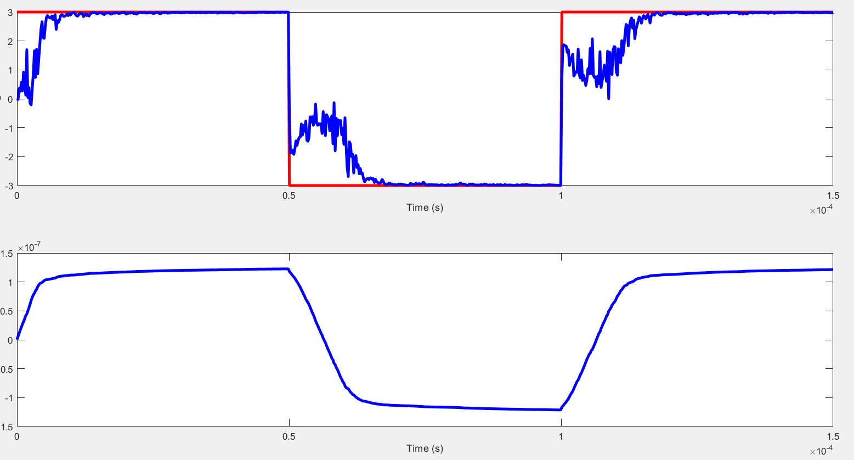
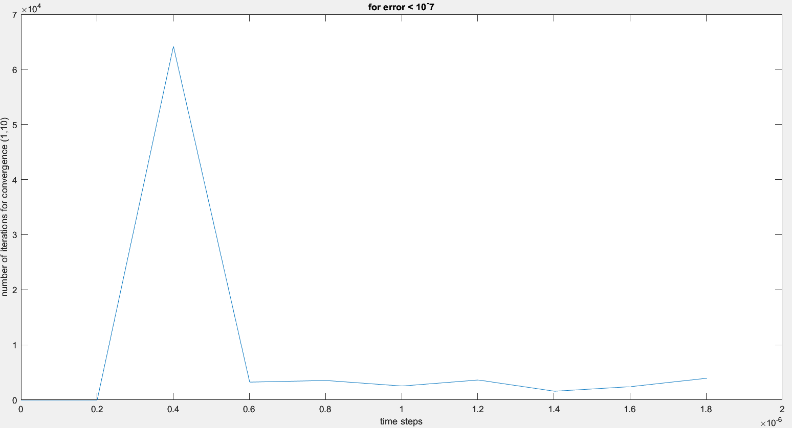
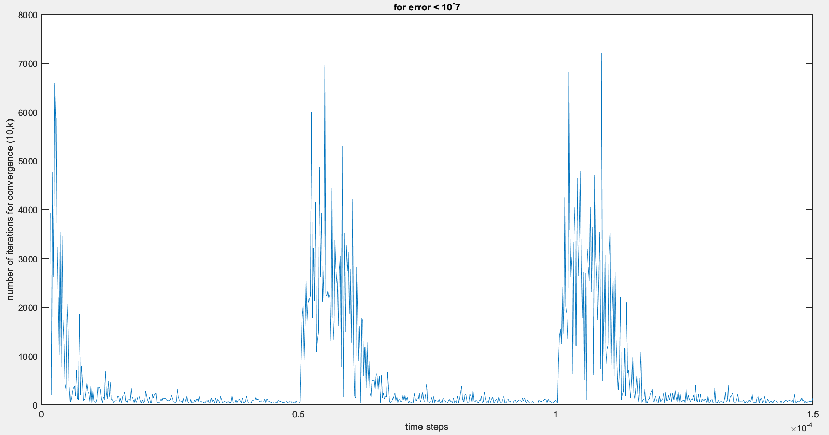
Iteration taken for each time step convergence
Result of the simulation
Parameters changed, err = 1e-7;
Inference the first convergence is taking more iteration 6.5*10^4

Slide 36
Tried giving guess value for the previous simulation result
But still the convergence speed is not improving
In fact it is bit slower than guessing with I*0.1

Slide 37
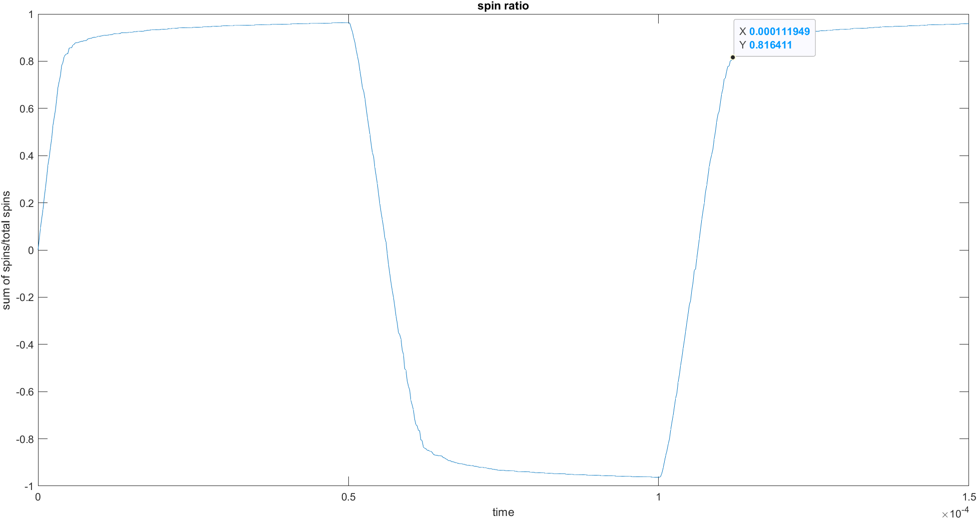
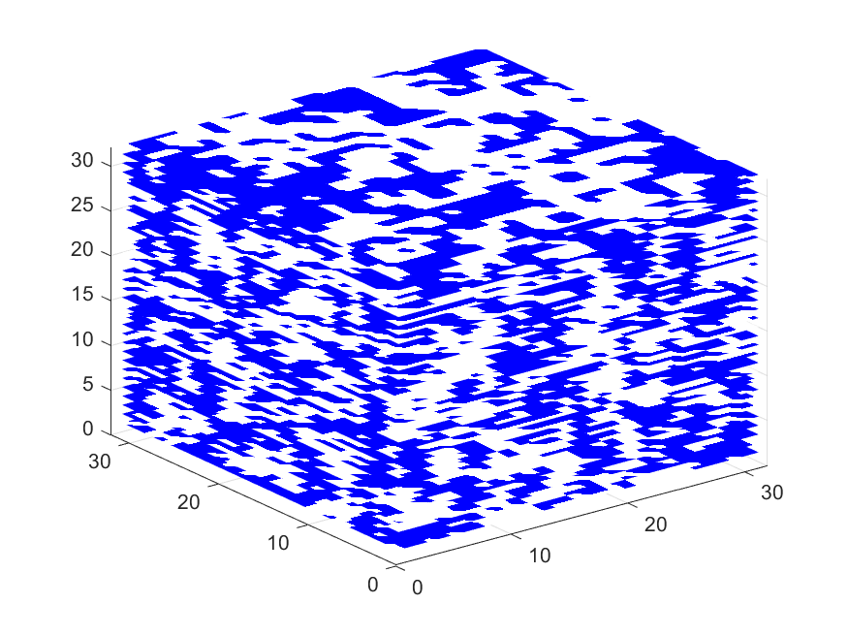
The spin ratio after each step is plotted

Slide 38
Spin flip animation

Slide 39
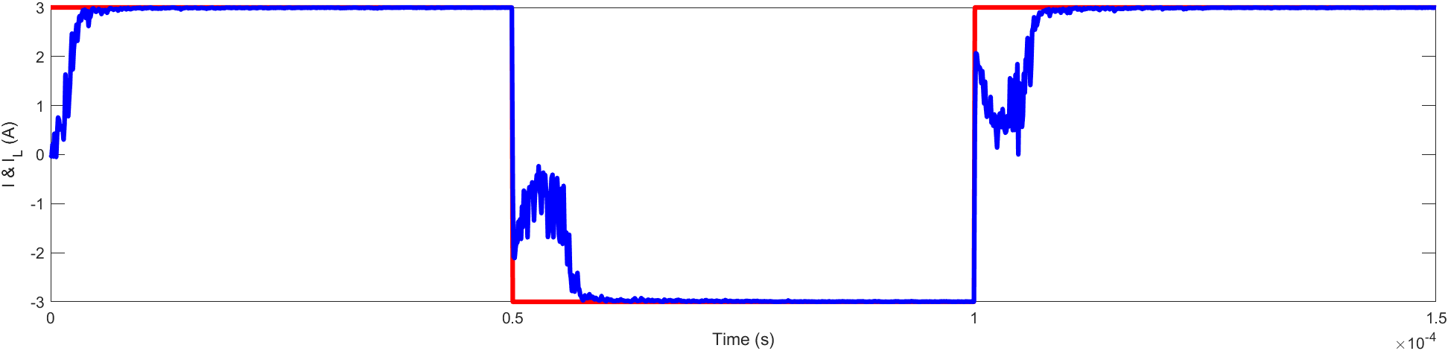
Improvement in simulation
Changed the dt to 1e-7 from 2e-7 what kept the divergence was the dt in dphi/dt so I replace the dt with dt1 which is 1e-7. now the system is converging.

Slide 40
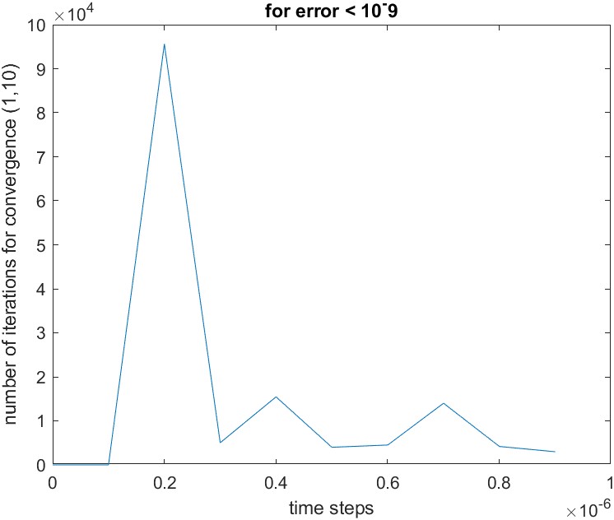

Improvement in simulation
Changed the dt to 1e-7 from 2e-7 what kept the divergence was the dt in dphi/dt so I replace the dt with dt1 which is 1e-7. now the system is converging.

Slide 41

Improvement in simulation2
Changed the dt to 1e-7 from 0.5e-7, and T to 0.5e-4,
sw_speed = 10e-7

Slide 42

Improvement in simulation3
Changed the dt 1e-8, and T to 0.5e-5,
sw_speed = 50e-7

Slide 44
Now to improve the first convergence
I missed one thing while trying out guess value improving (page no 36) that the phi value should also given as the guess results.

